Slide 1
High Mortgage Rates
November 1, 2022
Notes:
Hello everyone, to start, we are going to begin our story in 2014. You are looking to move somewhere and want to buy a house. You did all your research and narrowed it down to two cities, Denver, Colorado, known for great restaurants, hiking, the views, and so on, and Burlington, Vermont, known for…idk something out there. You are really leaning towards Denver Colorado…until you looked at the housing prices and noticed, wow these houses are way more expensive than Vermont. I mean look at this SHOWS PRICE COMPARISON IN 2014

Slide 2


Slide 3
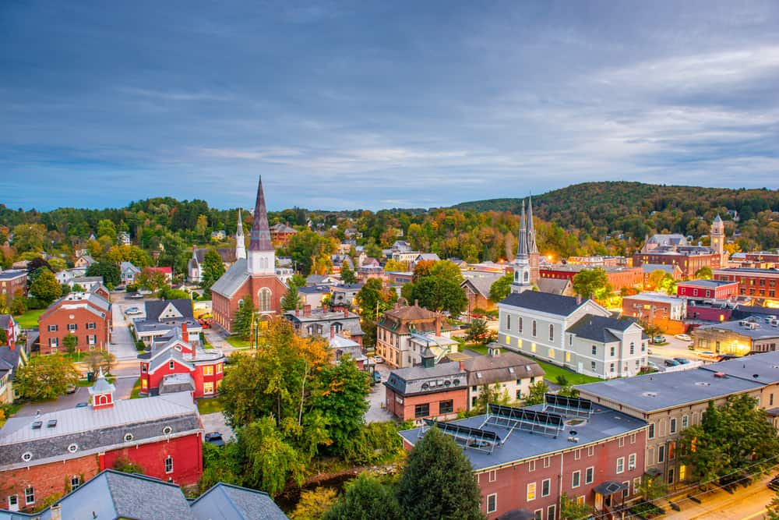

Slide 5
Hypothesis:
Housing prices increase at a greater rate when recreational cannabis sales are legalized.

Slide 6
Our Process
First Three States
Housing Price Index
“State Buds” and Relative Years
The first three states to legalize recreational cannabis sales in the continental US:
Colorado
Oregon
Washington
The FHFA HPI is a weighted, repeat-sales index, meaning that it measures average price changes in repeat sales or refinancings on the same properties. This information is obtained by reviewing repeat mortgage transactions on single-family properties whose mortgages have been purchased or securitized by Fannie Mae or Freddie Mac since January 1975.
Colorado : Vermont
Sales began
Oregon : Rhode Island
Sales began
Washington : New Jersey
Sales began
https://mjbizdaily.com/map-of-us-marijuana-legalization-by-state/
https://www.fhfa.gov/DataTools/Downloads/Pages/House-Price-Index-Datasets.aspx
Notes:
Sources
Flow chart (or similar) for cleaning process
We spent our first few hours together browsing data sets and talking about methodology. We came up with gems that allowed us to dive into this hypothesis. We narrowed our scope to the first three continental US states to fully legalize recreational cannabis. We discovered a metric called HPI- Housing Price Index- which is a statistically accurate measure of the movement of single-family house prices collected by the FHFA. I don’t want to get into the weeds, but if you’re curious about a more in-depth definition of HPI, please see…
For each of the three states we selected- Colorado, Washington, and Oregon- we analyzed the HPI data for the three years leading up to the first sales of legal recreational cannabis in each state. We used these findings to select a respective state buds for each of our original three- Vermont, New Jersey, and Rhode Island. The state buds shared a similar HPI in those three years leading up to the first weed sales. We then collected the data for the following three years, hoping to find an answer to our hypothesis.

Slide 7
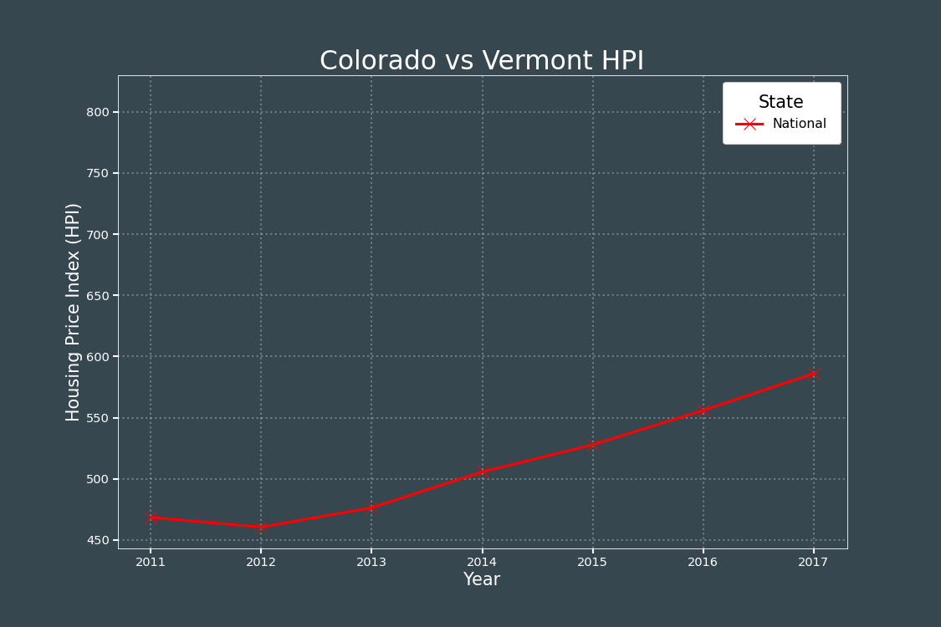
State by State
Notes:
State by State
National HPI - moderate positive slope
Vermont HPI - similar to national, stagnant slope
Colorado HPI - similar to Vermont pre-legal, then increases at much higher rate (point out legalization & beginning of sales)
Consistent data across groups
nonlegal - higher HPI then US, similar slope
Legal - similar HPI to nonlegal, then higher increase
Drawing conclusions
Investigate the change in HPI between the groups

Slide 8
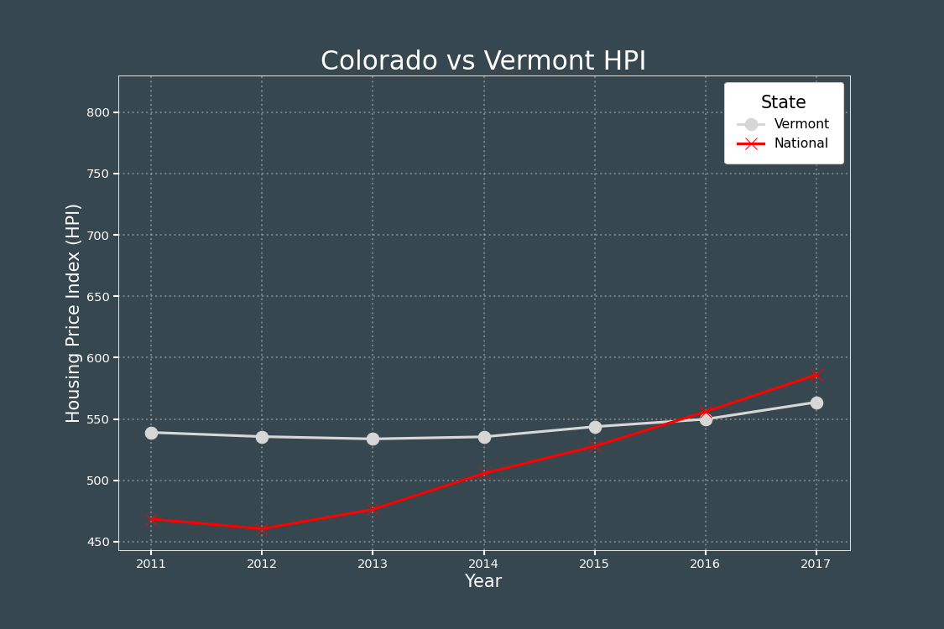

Slide 9
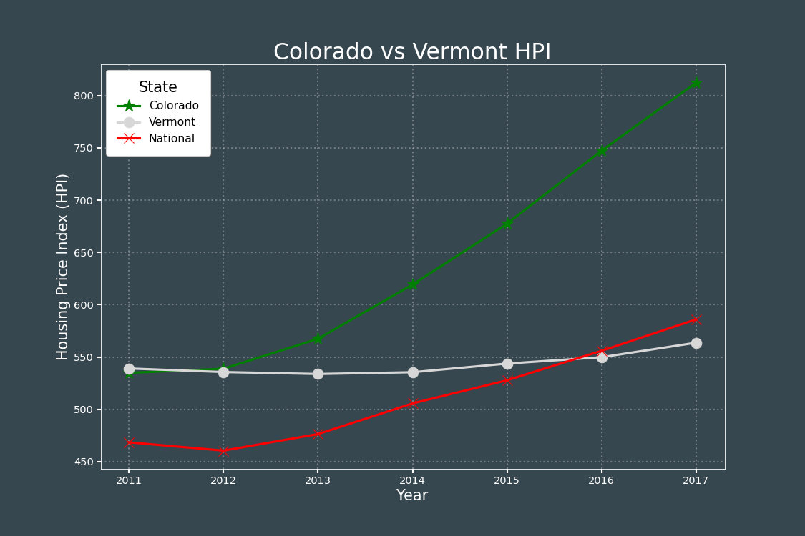

Slide 10
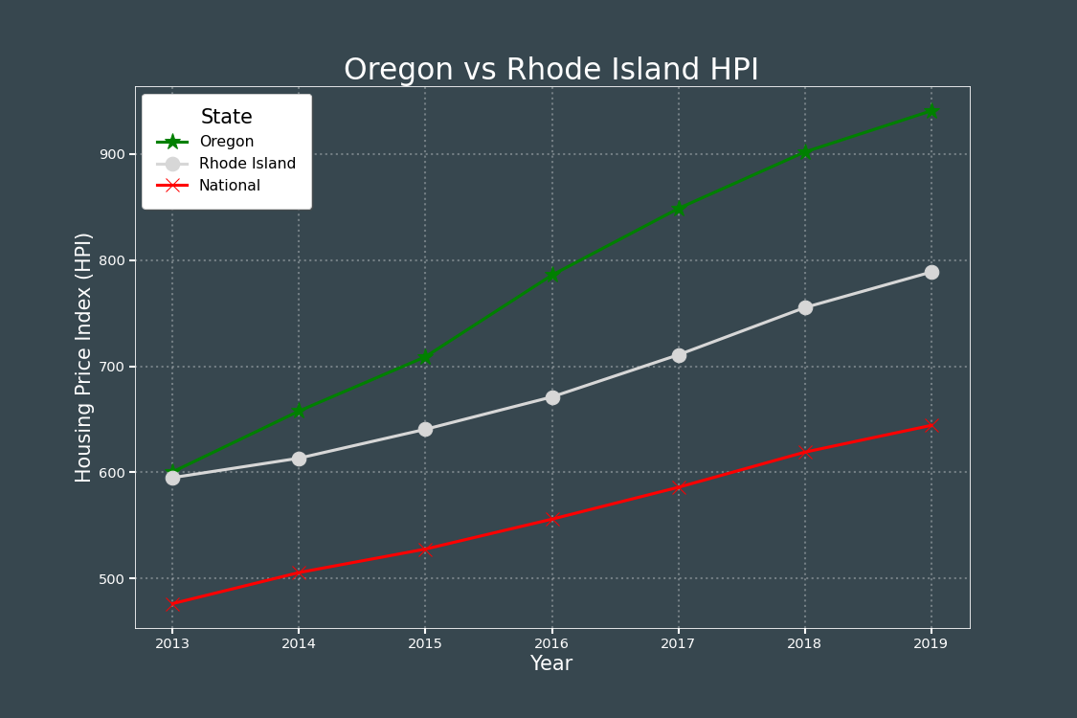
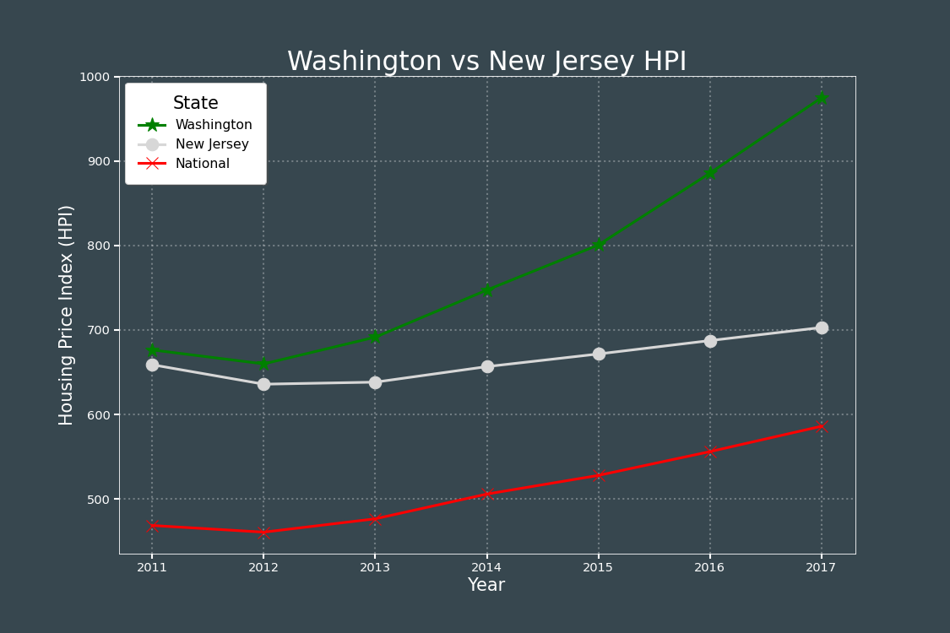

Slide 11
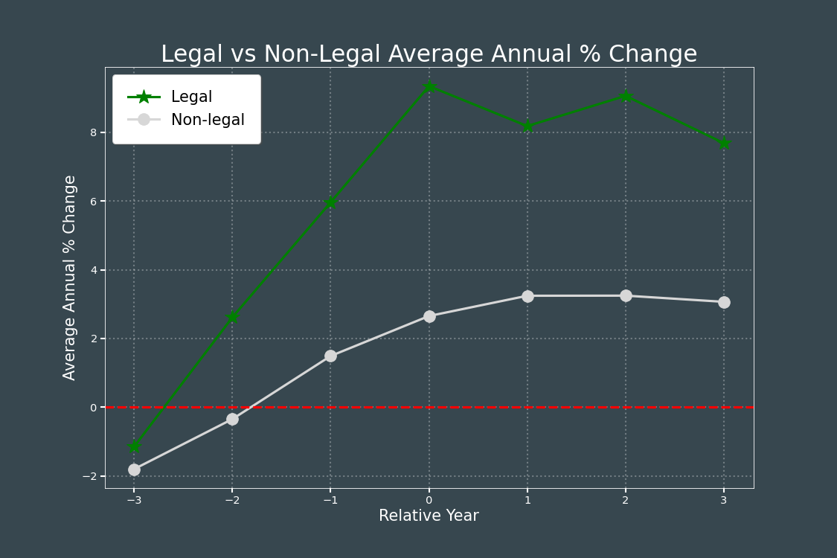
Legal versus Non-legal
Annual % Change is the % change in HPI relative to its previous year.
Relative Year is relative to the year on which a state’s recreational cannabis sales began (Year 0).

Slide 12
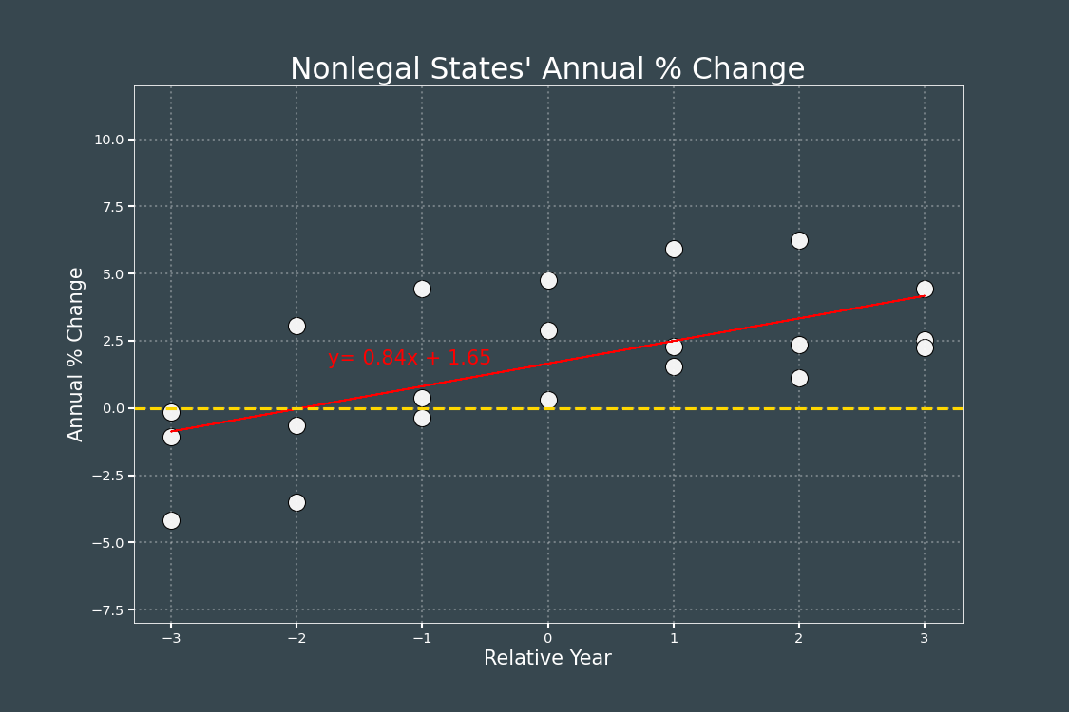
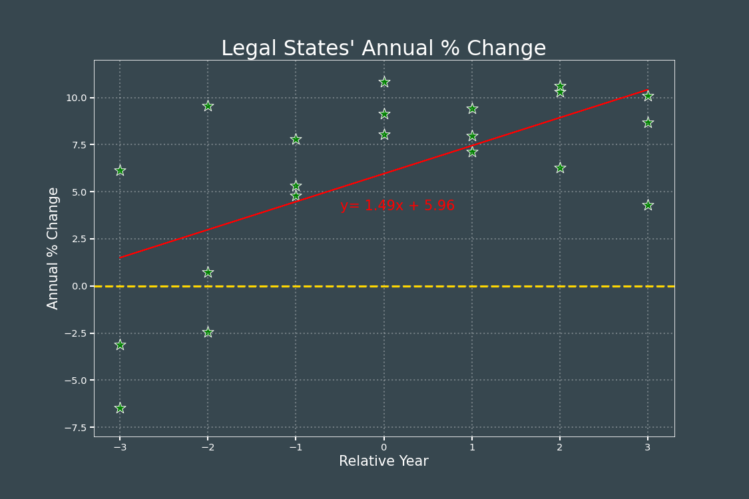
Pearson’s r = 0.6208
Pearson’s r = 0.6241
When grouped separately, both legal and non-legal states show positive correlation with Relative Year versus Annual % Change in HPI.

Slide 13
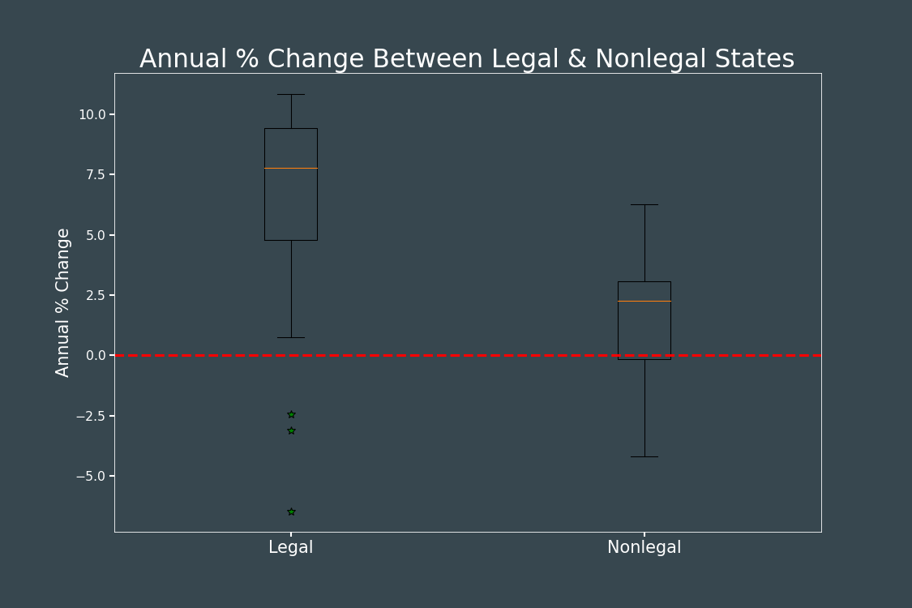
With the exception of outliers, the annual % change in HPI is significantly greater for legal states than non-legal states.
Notes:
Legal vs. Non-Legal
To analyze whether there is a significant difference between legalized versus non-legalized states, we changed up the following:
- Normalized the initial years that Matt covered into ‘relative years’, where the 0th year is the year that a legal state legalized cannabis sales, and
- Examined annual % change of HPI, not just the HPI.
Chart 1: Brought these elements together into one.
Chart 2&3: Separated legal and non-legal and determined what their linear regression best fit line would look like.
- Both had a significant p-value and had positive % growth in HPI.
Boxplot: Compared legal and non-legal % changes.
- Observed higher %s for legalized states, noting a few outliers (coming from the third/second year before Washington and Colorado legalized cannabis sales).

Slide 14
Conclusions

Slide 15





The Team
Paul Distasi
Justin Ho
Paul Han
Heather Adams
Matt
Data Analysis
Data Researcher
Project Manager
Visualizations
Code Master

